Slide 1
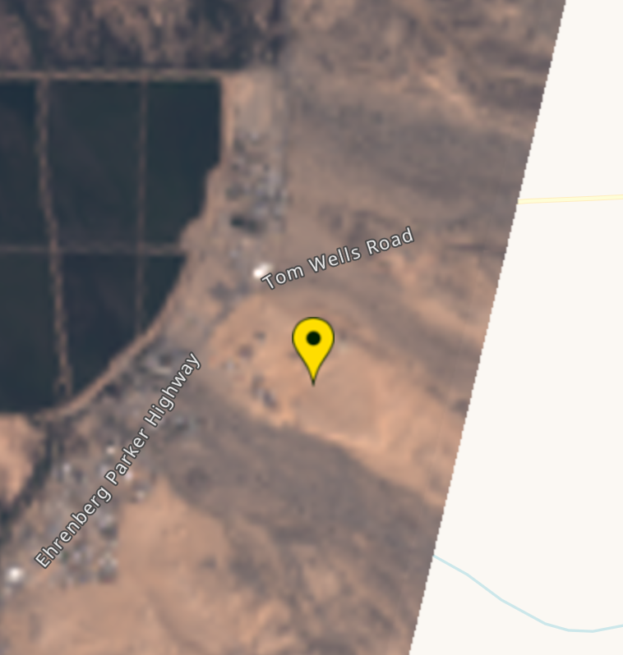
Stanford Gas Release Experiment
Methane Detection using Multispectral Instruments
Contribution from SRON, Leiden, The Netherlands
Date | Time (UTC) | Satellite | Successful methane Retrieval? | Assessment
21/10/17 | 18:22 | Sentinel-2 | Y | No plume
21/10/19 | 18:25 | Sentinel-2 | Y | Plume
21/10/21 | 18:11 | Landsat-8 | Y | Plume
21/10/22 | 18:35 | Sentinel-2 | Y | Plume
21/10/24 | 18:25 | Sentinel-2 | N | Cloudy
21/10/27 | 18:35 | Sentinel-2 | Y | Plume
21/10/28 | 18:16 | Landsat-8 | N | Clipping issue*
21/10/29 | 18:25 | Sentinel-2 | Y | No plume
21/11/1 | 18:35 | Sentinel-2 | N | Cloudy
21/11/3 | 18:25 | Sentinel-2 | Y | No plume
*Not enough observations around the location to perform a retrieval. See image

Slide 2
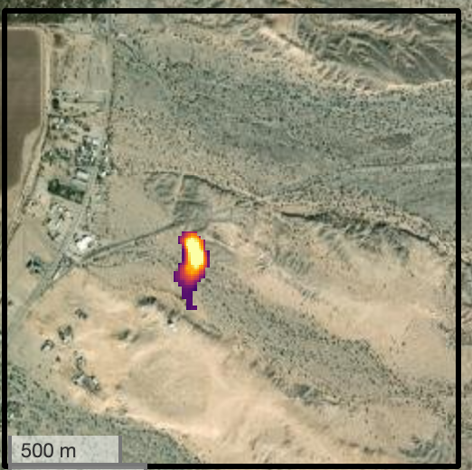
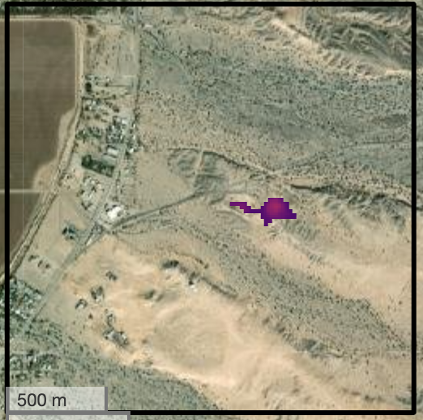
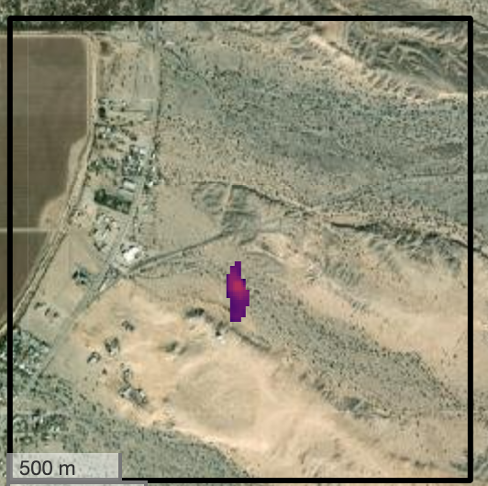
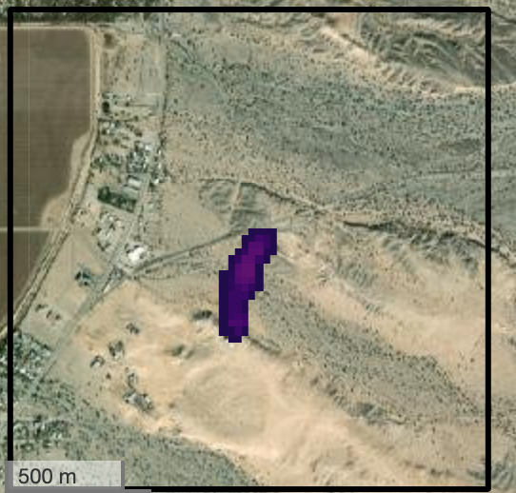
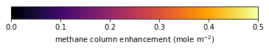
Date (satellite) | Plume length (m) | FacilityEmissionRate (kg/hr) | FacilityEmissionRateLower (kg/hr) | FacilityEmissionRateUpper (kg/hr) | UncertaintyType | Windspeed (m/s) [min-max*] | Wind Direction (azimuth degree)
2021-10-19 (S2) | 340 | 3760 | 1970 | 6260 | Min/max | 1.8 [0.8-2.9] | 175
2021-10-22 (S2) | 330 | 1160 | 570 | 2590 | Min/max | 1.4 [0.6-3.2] | 92
2021-10-27 (S2) | 260 | 2250 | 1440 | 2870 | Min/max | 3.8 [2.6-4.4] | 184
2021-10-21 (L8) | 490 | 1810 | 1418 | 2110 | Min/max | 2.2 [1.7-2.4] | 186
*Wind data are taken from ERA5 and GEOS-FP reanalysis at 1700, 1730, 1800, 1830, 1900, 1930 UTC.
Gas release location: latitude= 33.6306, longitude-114.4895
2021-10-19 (S2)
2021-10-22 (S2)
2021-10-27 (S2)
2021-10-21 (L8)
Background image credit : Esri, NASA, NGA, USGS, FEMA | County of Riverside, California State Parks, Esri, HERE, Garmin, SafeGraph, GeoTechnologies, Inc., METI/NASA, USGS, Bureau of Land Management, EPA, NPS, US Census Bureau, USDA | Maxar

